Slide 1
Children Of The Corn
Jackie Hegi, Robert Pace, Rachel Shockey, and Stephanie Stepp

Slide 2
Our Project
Plant Seeds
Soak Seeds In Warm Water
Fill Planter Trays With Peat Moss
Water Trays Thoroughly
Plant Corn
Cover With More Peat Moss
Water Again
Wait For Plants To Develop Incorrect Timing Can Cause Problems Later
Data Collection Observation and Recording of Each Plants Phenotype
Analyze Linkage
Sort Data
Find Central Gene
Calculate Map Units
Explore Difficulties
Distinguishing Phenotypes
Integrating Monday’s Group Data

Slide 3
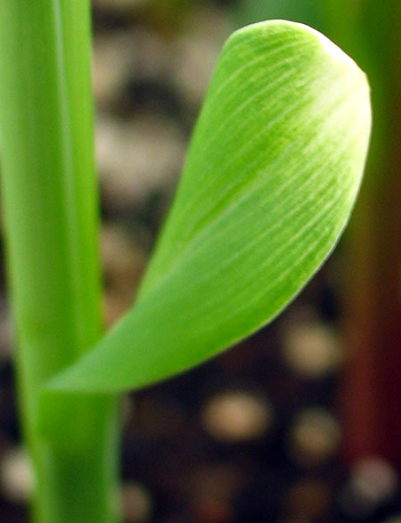
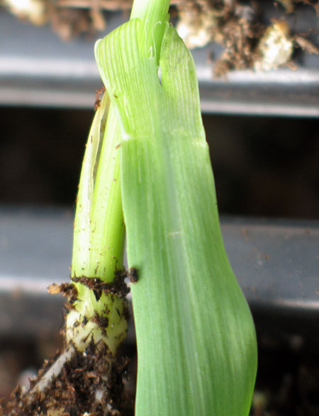
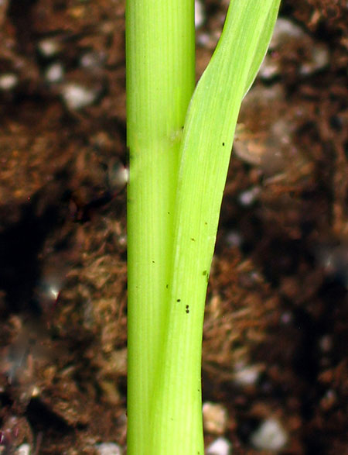
Mapping Of Three Mutant Maize Genes
White Tip (wt1)
The first few leaves do not contain chlorophyll in their tips.
Glossy (gl2)
These plants produces a different type of cuticle wax than normal, which gives a glossy appearance.
Liguleless (lg1)
These plants lack a common monocot structure called a ligule at their leaf/stem junction.

Slide 4
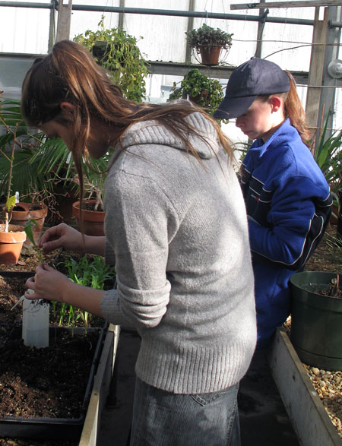
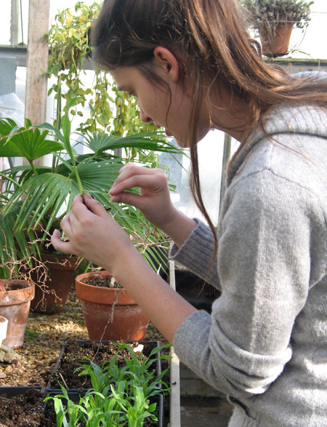
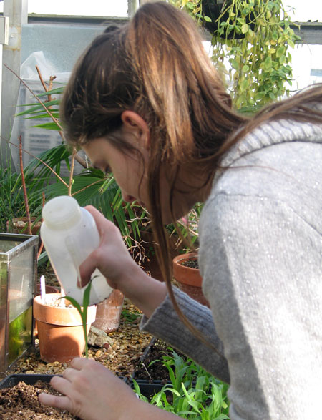
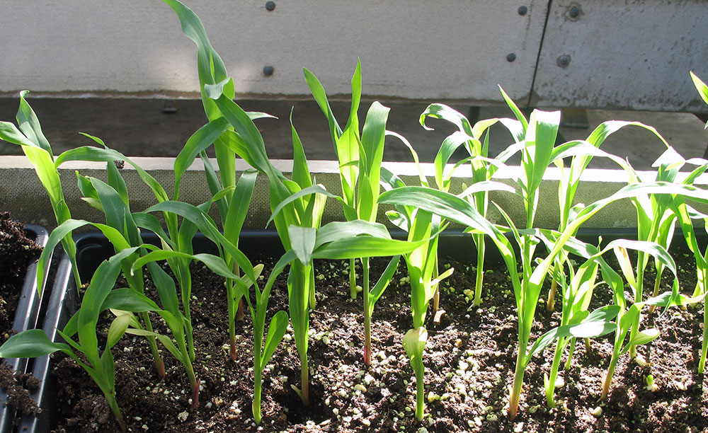
Collecting Our Data

Slide 5
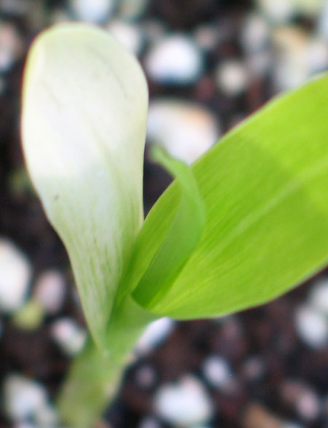
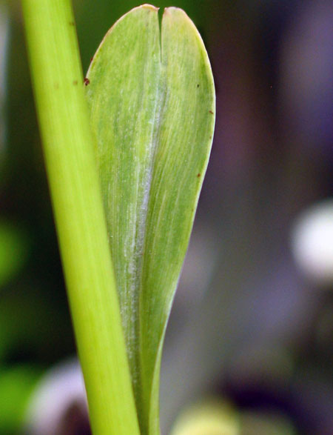
Mutant Phenotypes (White Tip)
White Tip (Mutant)
Normal

Slide 6
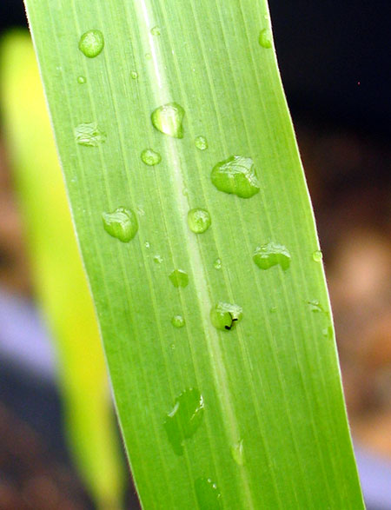
Mutant Phenotypes (Glossy)
Normal
Glossy (Mutant)

Slide 7
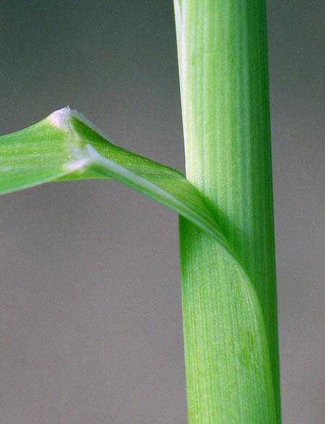
Mutant Phenotypes (Liguleless)
Liguleless (Mutant)
Normal

Slide 8
Our Linkage Analysis
Wt1 Gl2 Lg1 Frequency Group ____ + + Lg1 81 Non-Crossover Group wt1 gl2 + 63 + gl2 + 62 wt1 - gl2 Crossover Group wt1 + lg1 18 34.72 mu ( % error = 15.7 )
+ + + 20 gl2 - lg1 Crossover Group wt1 gl2 lg1 9 15.47 mu ( % error = 18.6 ) + gl2 lg1 11 Double Crossover Group wt1 + + 1 Totals: 265
|--------------- 34.72 mu ---------||----------- 15.47 mu ----------| Wt1 Gl2 L1

Slide 9
Encountered Difficulties
Distinguishing between Ligule & Liguleless in juvenile plants.
Distinguishing between White Tip & Normal in more mature plants.
Small Sample Size (265 plants).
Integrating Monday’s Group Data.

Slide 10
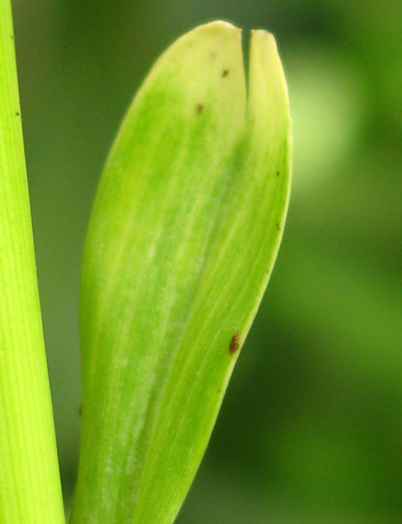
Distinguishing Phenotypes

Slide 11
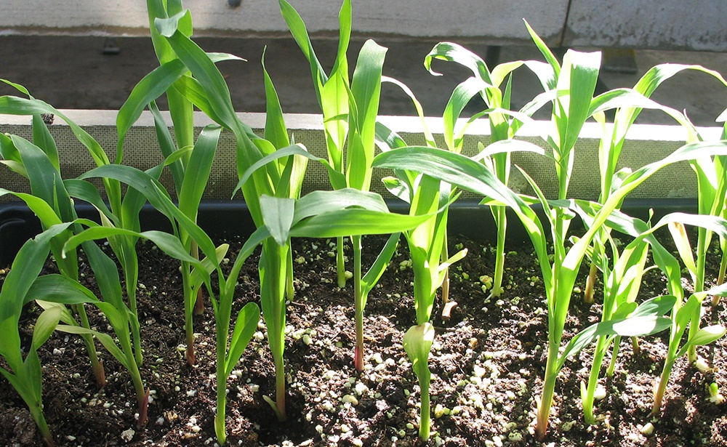
Distinguishing Phenotypes
Can You Spot The Ligules?

Slide 12
Differing Data – The Dilemma
Wt1 Gl2 Lg1 Frequency Group + + lg1 81 Non-Crossover Group + + lg1 20 wt1 gl2 + 63 wt1 gl2 + 13 + gl2 + 62 wt1 - gl2 Crossover Group + gl2 + 16 34.89 mu ( % error = 16.3 ) wt1 + lg1 18 34.72 mu ( % error = 15.7 ) wt1 + lg1 7 35.08 mu ( % error = 16.9 )
+ + + 20 gl2 - lg1 Crossover Group + + + 64 45.42 mu ( % error = 139.1 ) wt1 gl2 lg1 9 15.47 mu ( % error = -18.6 ) wt1 gl2 lg1 64 77.42 mu ( % error = 307.5 )
+ gl2 lg1 11 Double Crossover Group + gl2 lg1 40
wt1 + + 1 wt1 + + 24
Totals: 265/248/513 |--------------------- 34.89 mu ------------------||------------------ 45.42 mu ------------------| |--------------------- 35.08 mu ------------------||------------------ 77.42 mu ------------------|
|--------------------- 34.72 mu ------------------||------------------ 15.47 mu -------------------| Wt1 Gl2 L1 |--------------------- 30.00 mu -------------------||------------------ 19.00 mu ------------------|
KEY: Black = Integrated Data, Yellow = Our Data, Red= Monday’s Group Data

Slide 13
What If Ligules Phenotype Was Transposed?
Wt1 Gl2 Lg1 Frequency Group ____ + + + 145 Non-Crossover Group wt1 gl2 lg1 127 + gl2 lg1 78 wt1 - gl2 Crossover Group wt1 + + 42 30.21 mu ( % error = 0.7 )
+ + lg1 40 gl2 - lg1 Crossover Group wt1 gl2 + 22 18.91 mu ( % error = -0.47 ) + gl2 + 27 Double Crossover Group wt1 + lg1 8 Totals: 513
|--------------- 30.21 mu ---------||----------- 18.91 mu ----------| Wt1 Gl2 L1

Slide 14
Credits & Thanks
Credits
MaizeGDB. (2009). Chromosome 2 Map. Retrieved February 22, 2009 from http://www.maizegdb.org/cgi-bin/displaymaprecord.cgi?id=1203638
Forest Laws, (2008). Corn Genome Mapped. Southeast Farm Press, March 12, 27,33
R. Velasco, C. Korfhage, A. Salamini, E. Tacke, J. Schmitz, M. Motto,F. Salamini, H.P. Döring (2002), Expression of the glossy2 Gene of Maize During Plant Development. Maydica, Volume 47 (2), 71-81
Lisa Harper, Michael Freeling (1996). Interactions of ligueless1 and liguleless2 Function During Ligule Induction in Maize. Genetics, Volume 144 (4), 1871-1882
Jinwon Lee, Jong-Jin Park, Song Lim Kim, Lieun Kim, Gyneheung An (2007). Mutations in the rice liguleless gene result in complete loss of the auricle, ligule, and laminar joint. Plant Molecular Biology, Volume 65 (4), 487-499
Eckhard Tacke, Christian Korphage, Detlef Michel, Masimo Maddaloni, Mario Motto, Simona Lanzini, Francesco Salamini, and Hans-Peter Döring (1995). Transposon Tagging of the Maize glossy2 locus with the transposable element En/Spm. The Plant Journal; For Cell and Molecular Biology, Volume 8 (6), 907-917
Thanks to:
Dr. Pat Calie Dr. Stephen Richter

